Slide 1
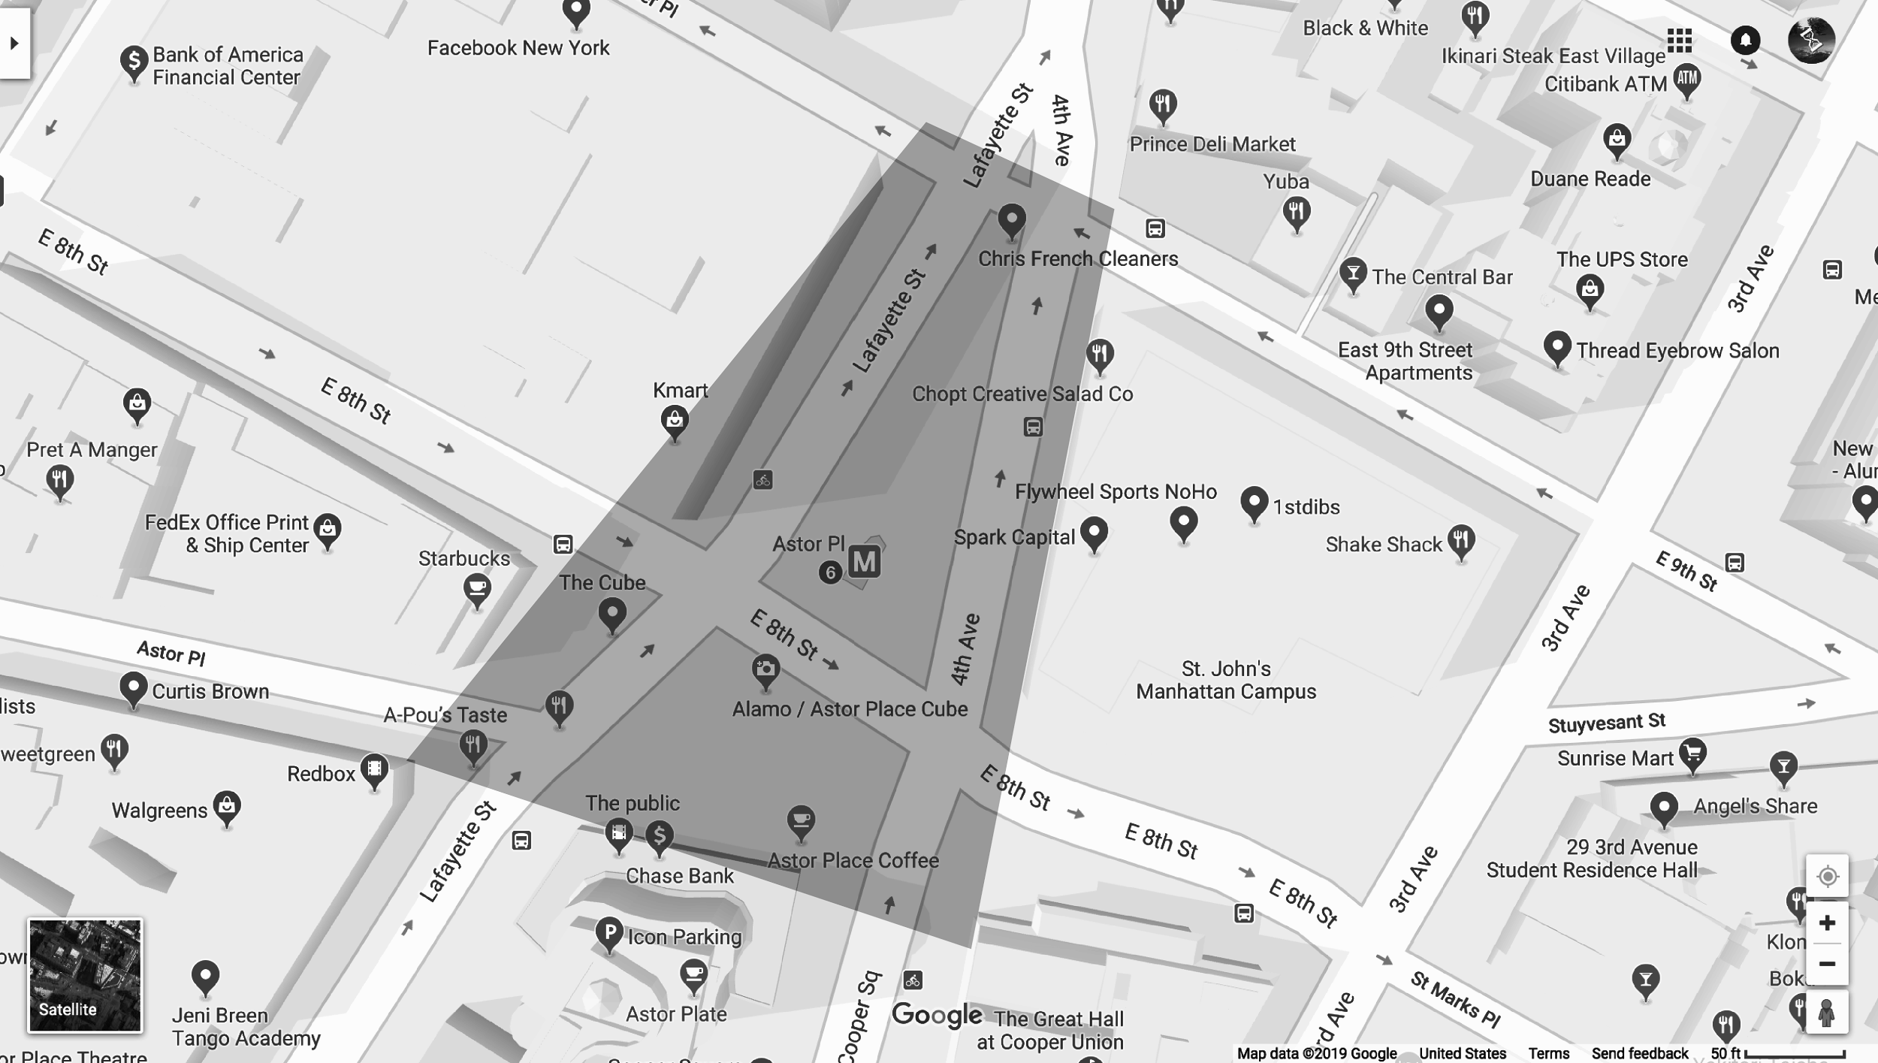
Notes:
12.00 to 12.10 minutes :
So we’ve all gone on this little journey if that’s what one may call it - Today we’ll start with a brief chat about our experiences in Astor Place and land here together. Then I’ll introduce our map, what we might do with it, and we’ll break off in pairs to speak about our encounters. Following that, we’ll share our findings to each other and have a discussion about them. Lastly, I’ll give you a framework of the location we’ve all visited, such as the bureaucratic nature of the space, in addition to why I’ve decided to call this the anti-drift lab.
--So, did you uncover things you hadn’t before? Does this place mean something else to you now? What kind of details stood out to you most?

Slide 2
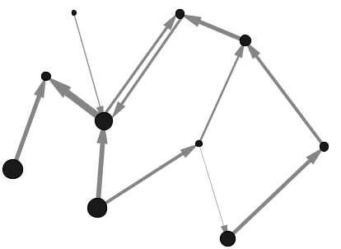
THE MAP OF THE ENCOUNTER OF THE ENCOUNTERS
Notes:
12.10 to 12.15 example prez
So I’ve become interested in the associations and relations that exist between different infrastructural elements in the city. I’d like to share that process with you - so I’m going to ask you to pair up & before talking to each other about your chosen element - I’d like you to think specifically about what this element may be caring or maintaining or facilitating or repairing & in turn who or what cares/maintains/faciliates and repairs it.
Create a small mind map on your piece of paper (perhaps referencing from the notes you took in the field guide)
When you do speak together, try to see if there might some kind of association between your element and the other person’s. Do they influence each other maybe? Are they dependant upon each other? Are they part of a bigger system ? Think loosely and abstractly. Keep these associations in mind, because when you’re done speaking, I’d like you to place your image/thing on the map here where it is that you found it and perhaps create some kind of arrow to your partner’s element. (if applicable)
Present example of fake rock [speak about MONOPINES] and signage
12.15 - 12.25 --mind maps, talk and find yourself on the map
12.25 - 12.40-12.45 - share and discuss
Think about this on a material level, in addition to a nonhuman level (is this element in some way obstructing or facilitating the flight of birds? Is the rock disguised in favor of critters that crawl the streets?)
What does it mean for a human body to experience a city? For whom are cities designed, and how does this shape experiences for others?
( have your markers ) → find yourself. And as people go along while they are speaking feel free to draw directional arrows between the elements (perhaps we’ll explain perhaps we wont lets see what happens).

Slide 3
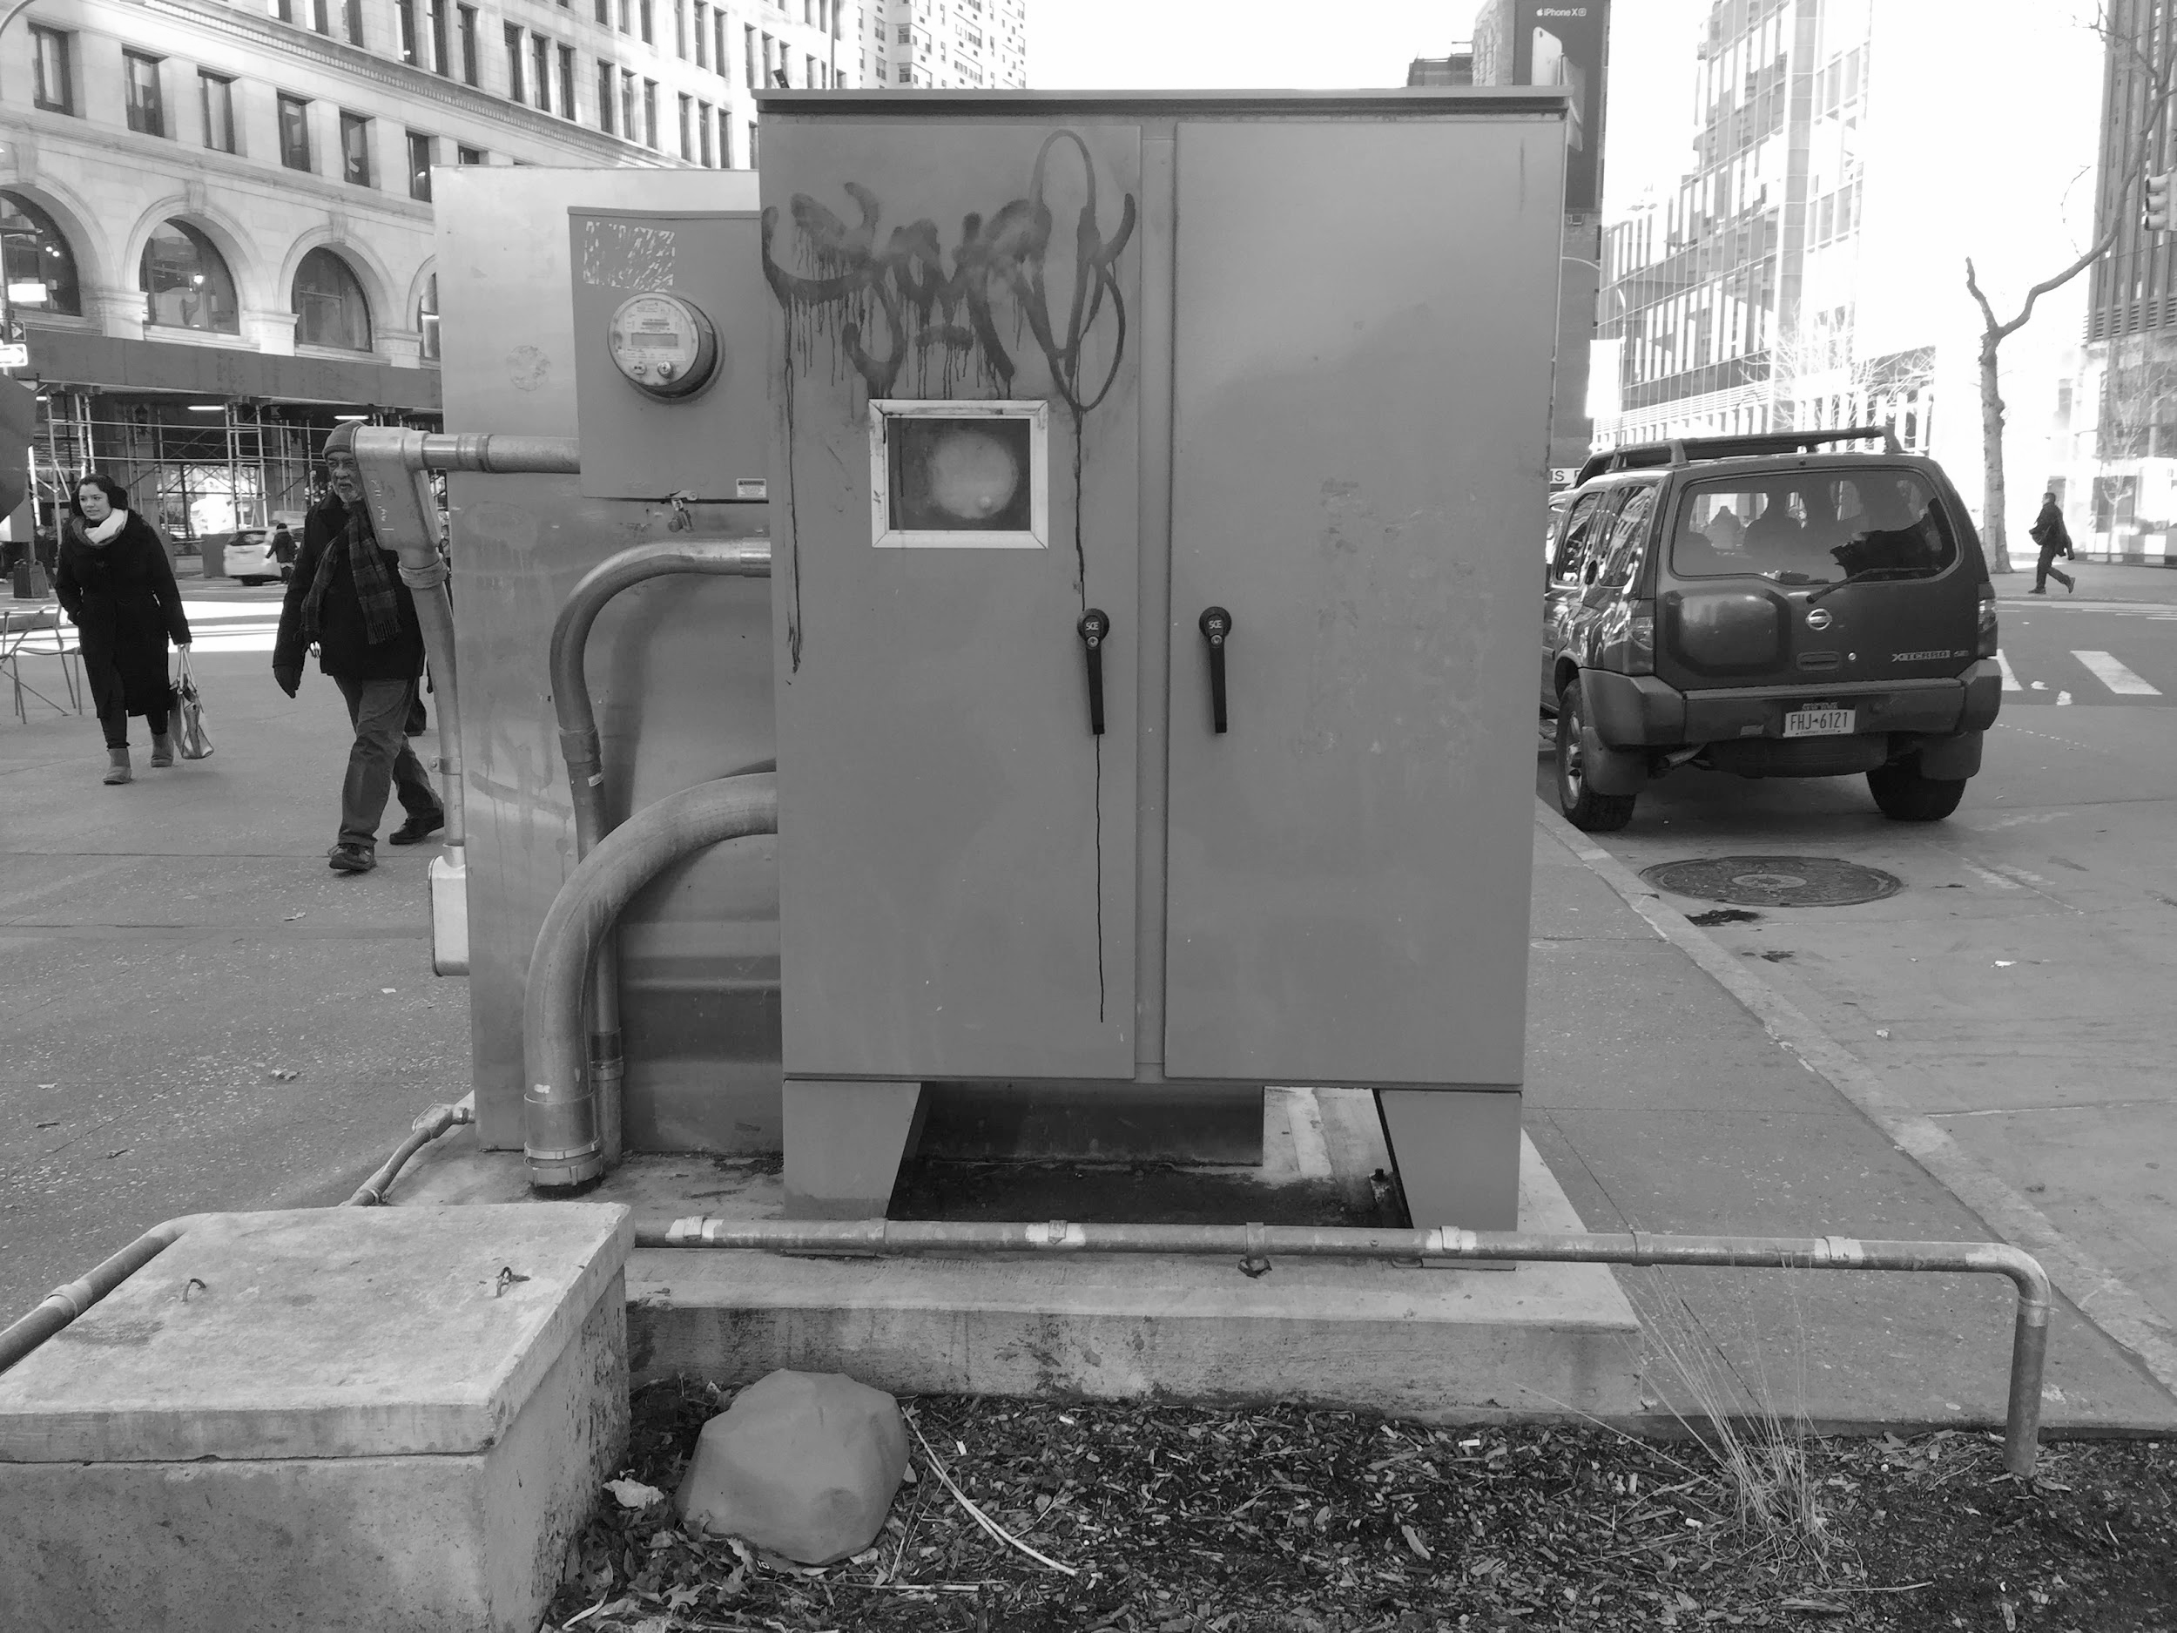
“We should also remember that the preservation of our world — the human one — is sometimes at odds with caring for the ecological context. Perhaps not every road should be repaired. Geographer Caitlin DeSilvey encourages us to embrace entropy within the built world, to ask ourselves for whom we engage in preservation, and to consider cultivating an acceptance of “curated decay” where appropriate. ⁴³”
Notes:
I WENT ON A ‘DRIFT’ MYSELF AND AMONGST OTHER THINGS I DECIDED TO FOCUS ON THIS.
I ASKED THIS DUDE AND HE TOLD ME THE CITY…
WHO ARE WHAT IS THE ‘CITY’?
MAYOR → CITY COUNCILS → BOROUGH PRESIDENTS
TO THINGS LIKE:
MTA
OFFICE OF EMERGENCY MANAGEMENT
DEPT. OF BUILDINGS
URBAN PLANNERS
NYC PARKS
A LOT OF NON-PROFITS
&
IN many cases private firms are responsible for the design and maintenance of public spaces
(I did a lot of research on POPs last year).
THE DOT

Slide 4
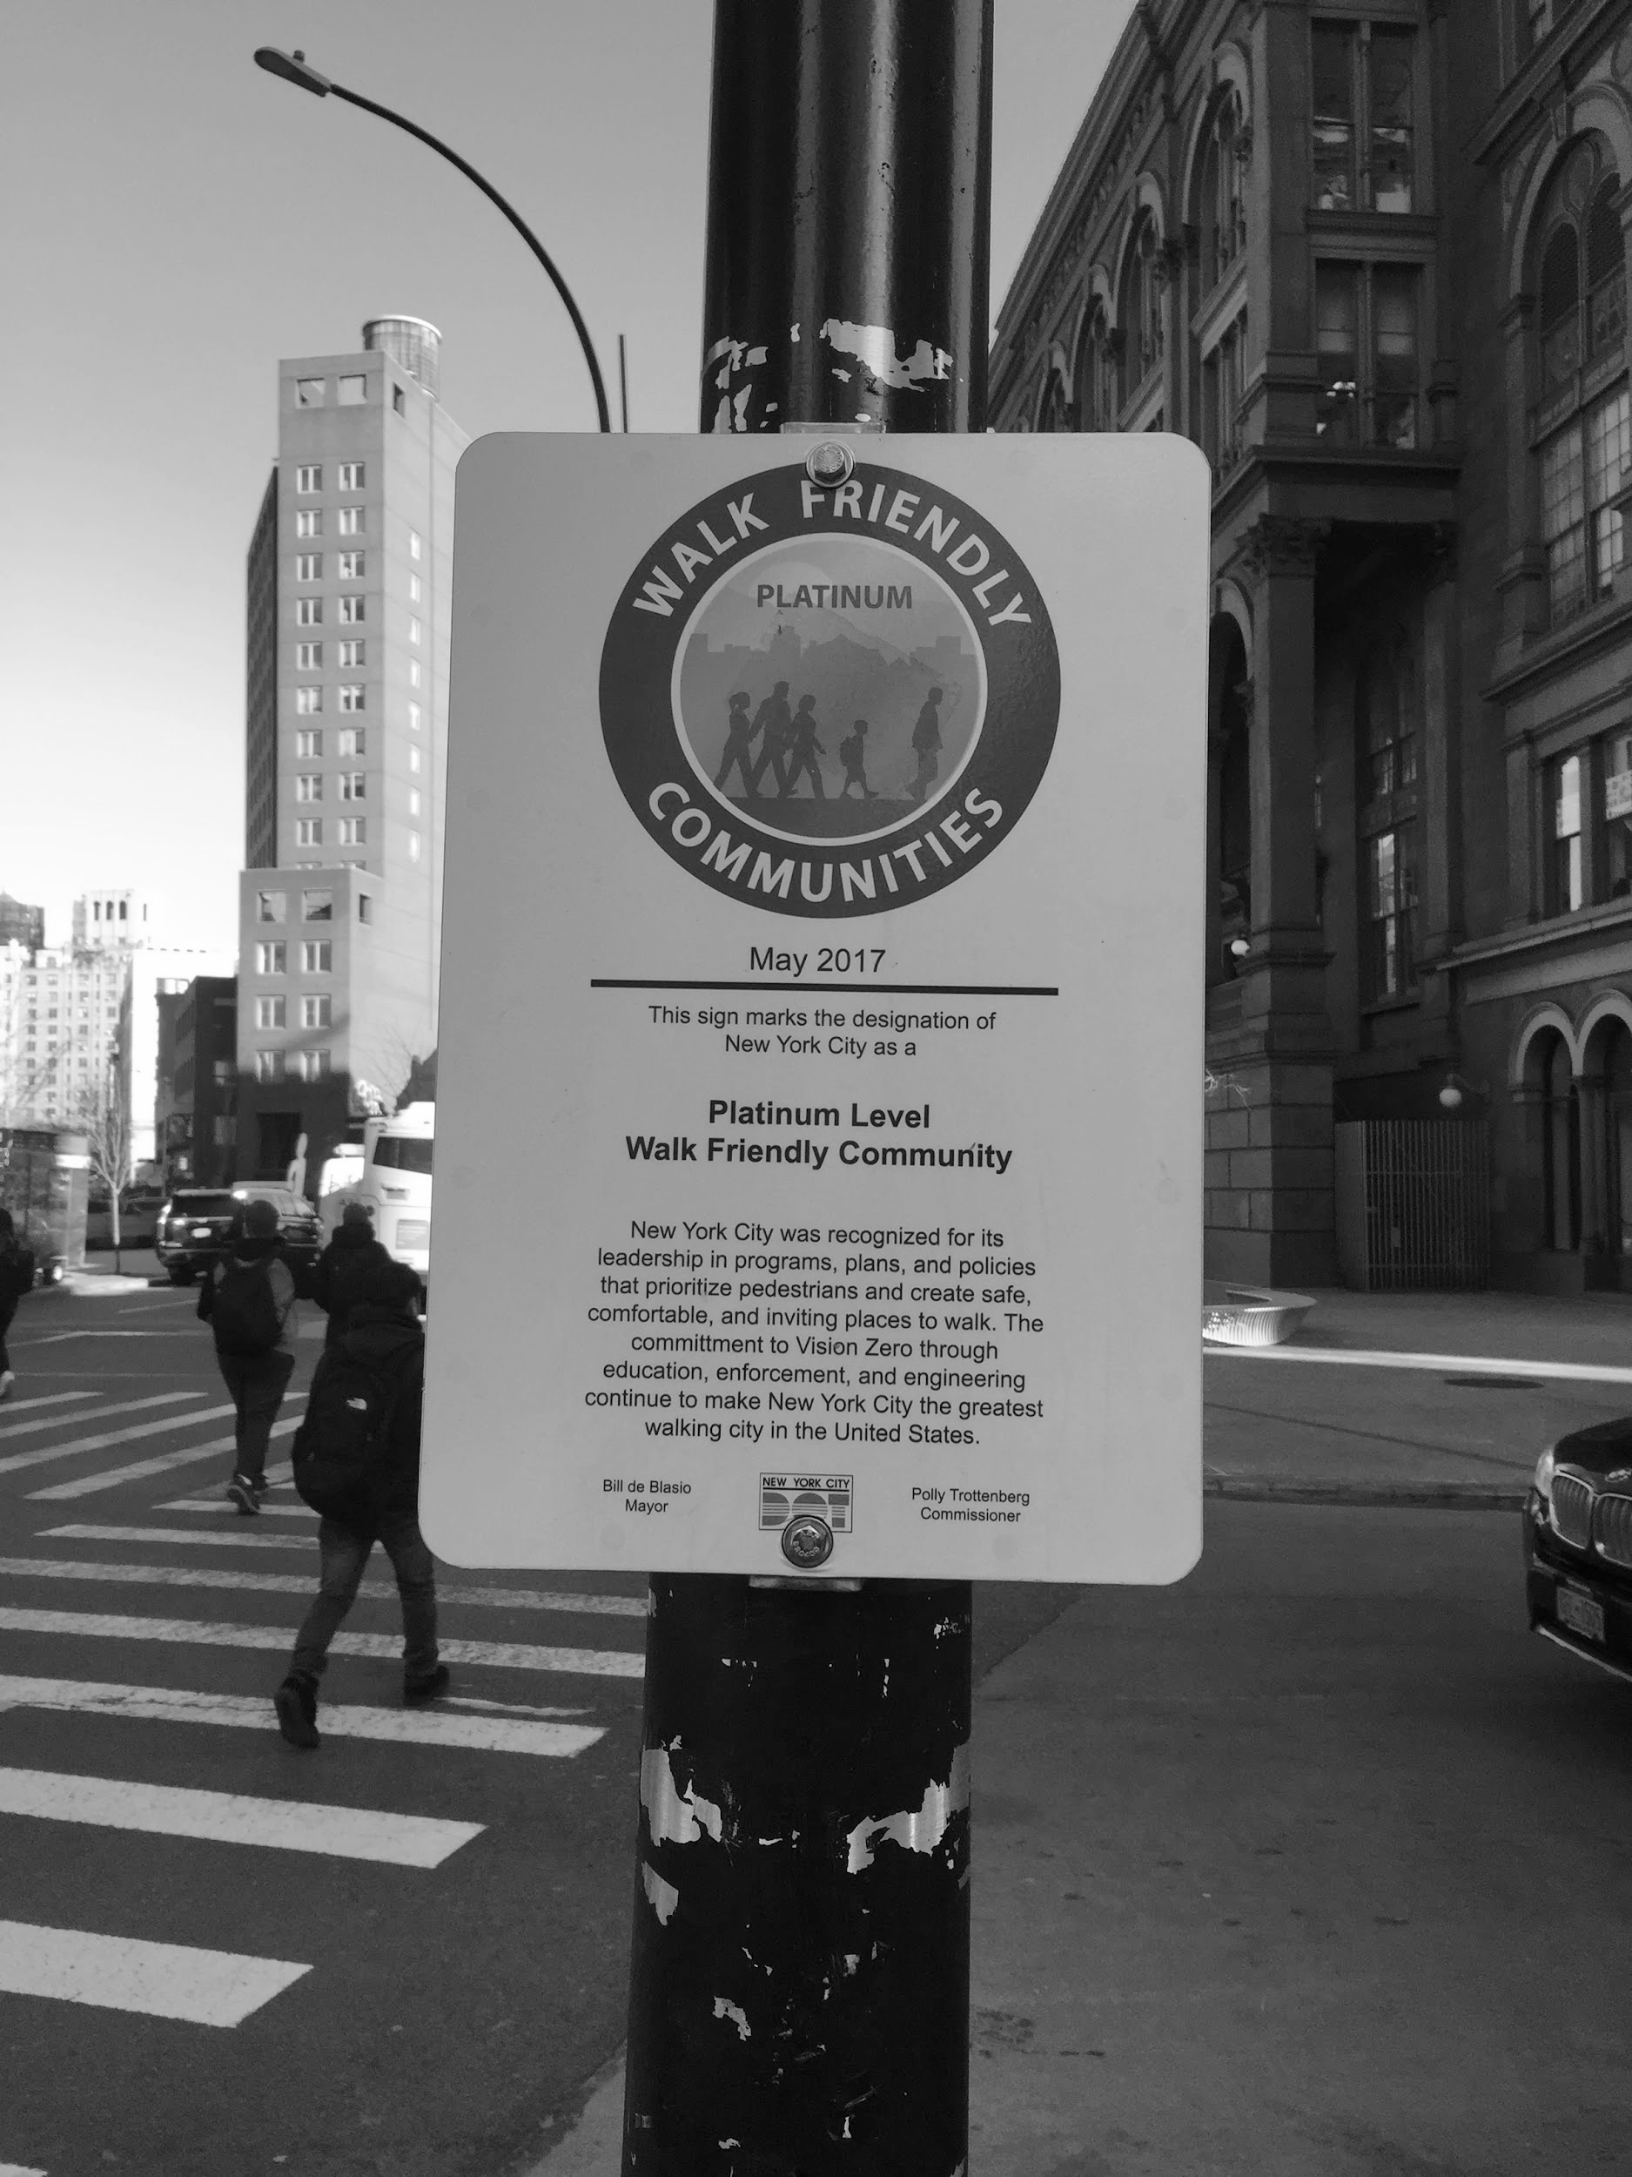
DOT
THE VILLAGE ALLIANCE
Notes:
WHO OR WHAT IS A PEDESTRIAN PLAZA?
** these are meant to to cater to a greater amount of safety for pedestrians (and cyclists) and cars.
DOT works with selected organizations [so in this case they work with the Village Alliance] to create neighborhood plazas throughout the City to transform underused streets into vibrant, social public spaces.
“The NYC Plaza Program is a key part of the City's effort to ensure that all New Yorkers live within a 10-minute walk of quality open space.”
https://www.dnainfo.com/new-york/20141008/east-village/supercomputer-that-won-jeopardy-moves-new-ibm-offices-astor-place

